Slide 1
Efficient, Joint-Based Skeleton Action Recognition
Nicolas Fleece, S# 8327287 Supervisor – Dr. Robert Laganière

Slide 2
Thesis Aim
Develop a robust lightweight pose-based action recognition framework that has reasonable accuracy and is resistant to changes in the background.
Notes:
- This is the aim of the thesis

Slide 3
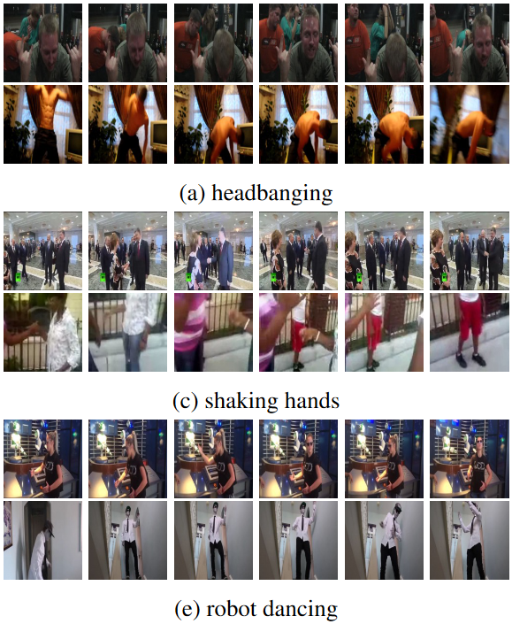
Action Recognition
Complex problem with many different challenges
Background information is constantly changing such as the camera moving, or people moving around in the background not related to the main action
Two people may not perform an action the same way, i.e. walking up stairs, jumping, catching a ball

Slide 4
Motivations
Issues with current models
Too Large
Susceptible to background interference
Notes:
- Large models such as the ones developed my Microsoft, Facebook, etc. cannot be run on less modern hardware -- smartphones
- Smaller models are better, but are often susceptible to some background interference which makes them difficult to run in the wild
- So we aim to solve both these problems with a small model invariant to most kinds of background interference

Slide 5
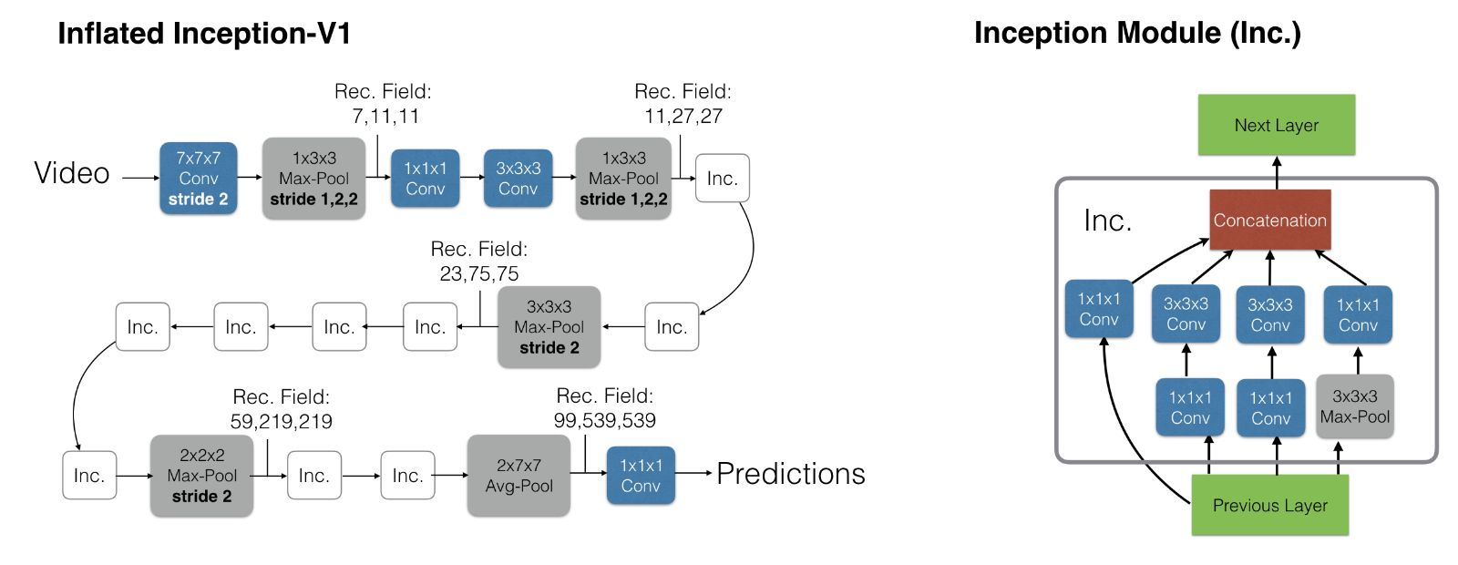
Large Action Recognition Models – I3D

Slide 6
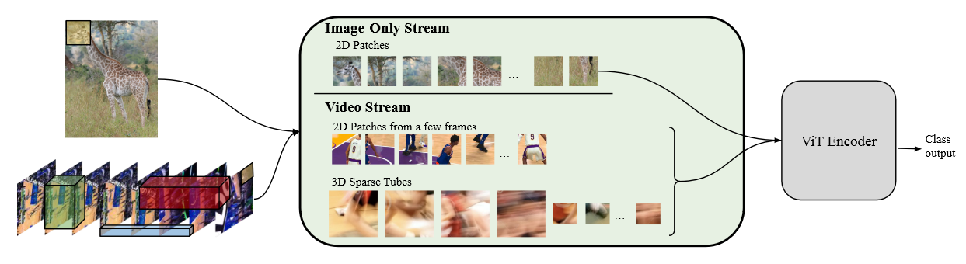
Large Action Recognition Models - TubeViT
Large Model

Slide 7
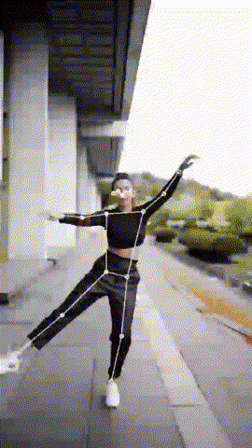
Pose
Pose is crucial to avoiding background interference
Existing lightweight 2-D pose models have proven effective
Potential background interference introduction
Not relevant in our analysis as will be explained later
All pose models subject to this same interference
Notes:
The answer to this question is to turn to pose
Pose allows us to focus on the movements of the person and filter out some of the background
The pose models available to us today have proven to be rather good at extracting this 2 dimensional pose
however it’s worth noting that the introduction of these pose models will introduce some error, however for our analysis this won’t be relevant in our analysis for reasons I’ll speak to later

Slide 8
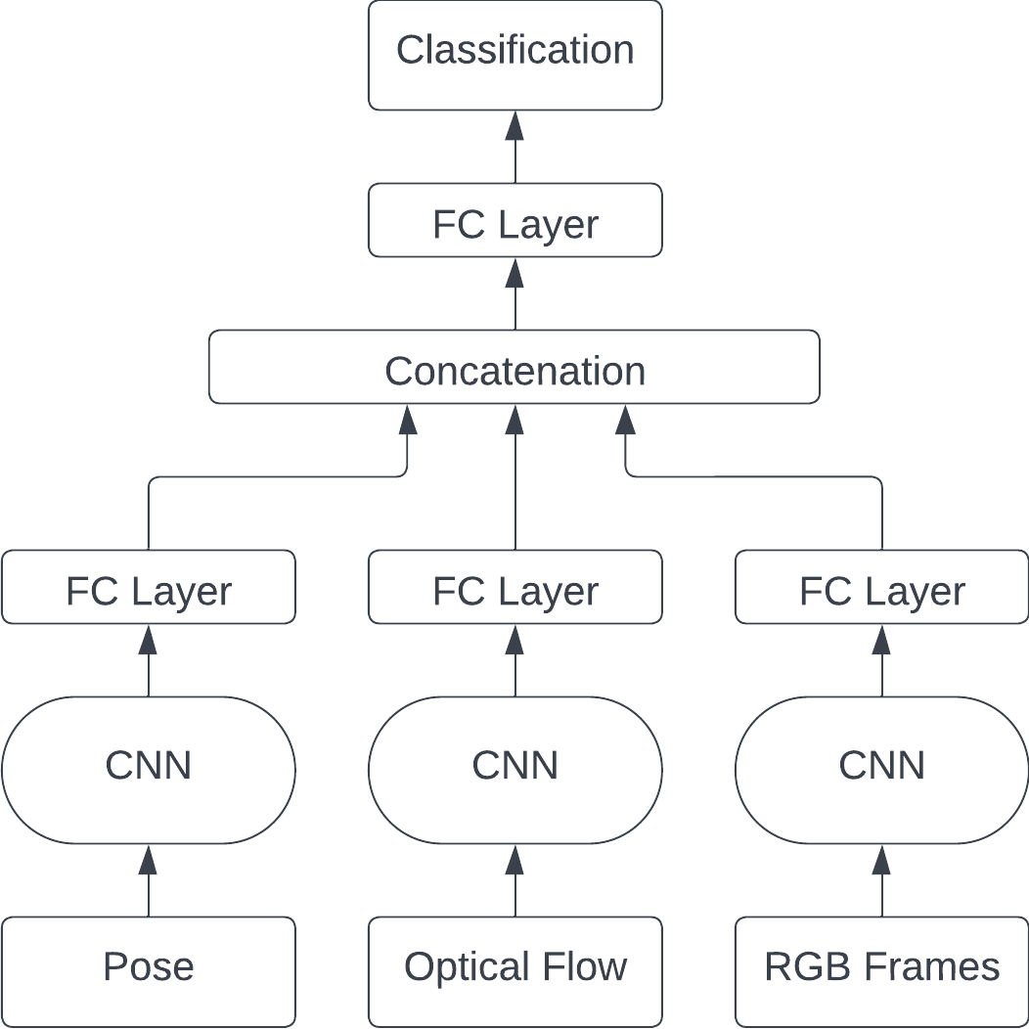
Pose-Based Models
Fused Architecture
Uses Pose, Optical Flow and RGB parts separately, concatenating them at the end
Typically utilize complex 3D-CNNs
Notes:
From this extracted pose we can construct what a classic model might look like, in this case a “fused” architecture
In this model the pose, optical flow, and rgb frames are passed through what is typically a complex 3d cnn and concatenated after to form an output

Slide 9
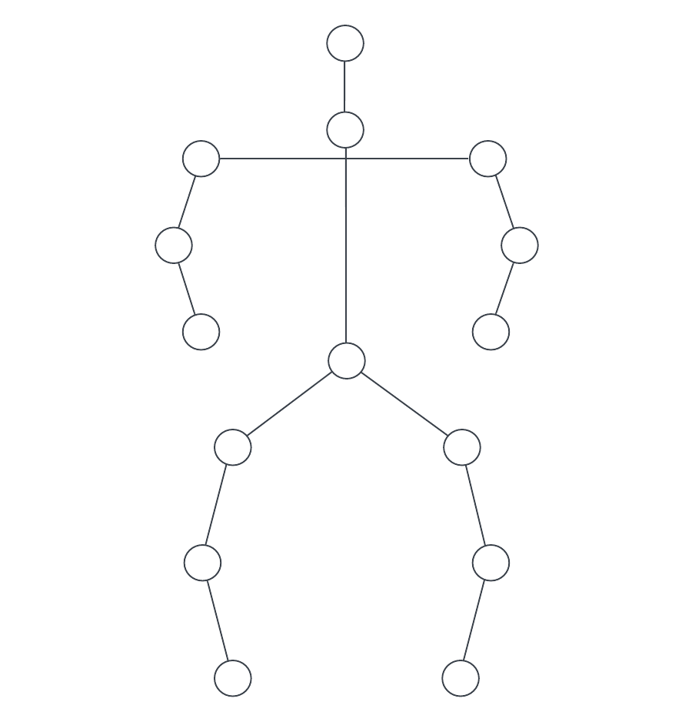
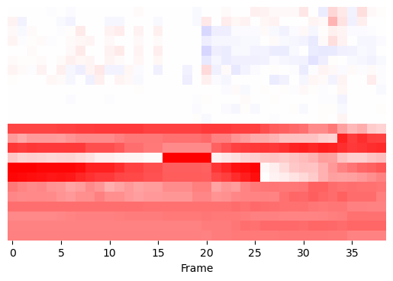
Intermediate Representations
Smaller Model
Notes:
The question of efficiencies start to be raised when it comes to these models and how the pose is processed
Some models choose to construct “intermediate representations” in order to condense the pose data down into a more workable form
This means that the end model used to process the pose data can be much smaller, typically the end goal being a relatively compact 2d cnn

Slide 10
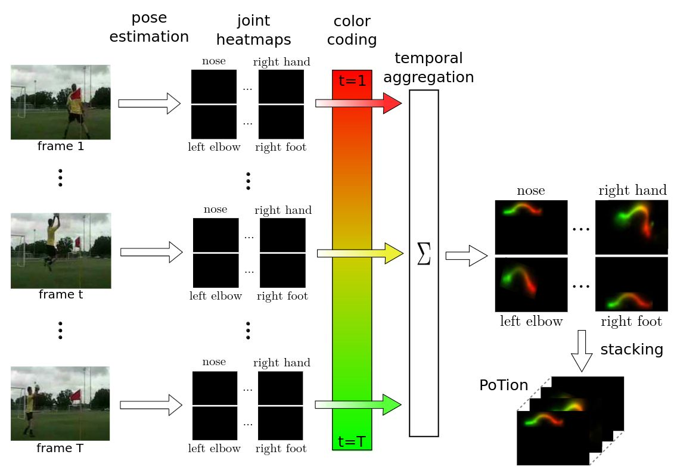
PoTion: Pose MoTion Representation for Action Recognition
The PoTion leverages typical joint heatmaps that are often exported by pose estimation models
Maps individual joints from start to end, assigning them a ‘colour’ based on frame index
i.e. shifts from green → yellow → red
Construction of this image allows for processing using basic 2 Dimensional CNNs
Notes:
An example of an intermediate representation would be PoTion
They use the joint heatmaps at each frame of the image, and using a ‘colorization’ technique where in this case, the joint heatmap at any frame is given a color that transitions from green to yellow to red
These are then combined into one image where there is a line moving through this color coding
These images can then be stacked

Slide 11
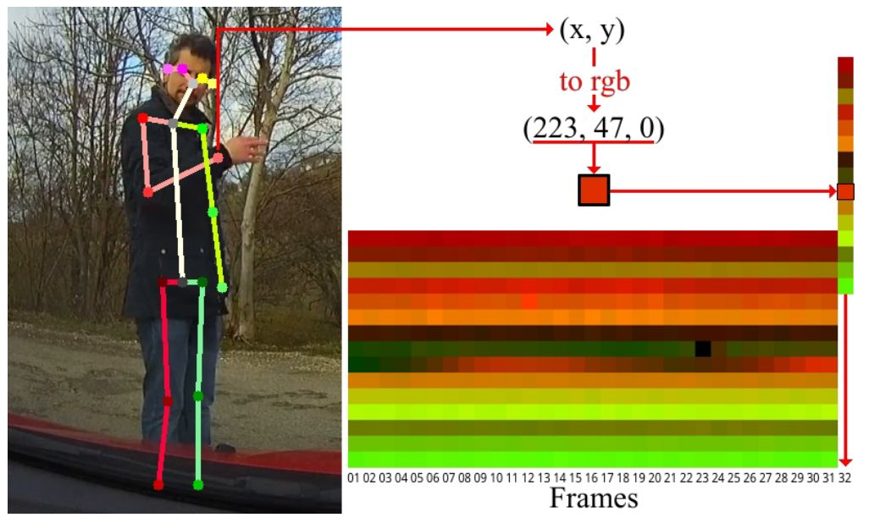
Simple yet efficient real-time pose-based action recognition
This paper proposed the EHPI (Encoded Human Pose Image) representation, which was a direct inspiration for the works in this thesis
Very simple in its construction of a 2-Dimensional “image”
Take x and y positions of the joints, stack them to form one column per frame
Line the stacks up to create an image of the whole video
Problem – Very susceptible to background interference
Notes:
Another intermediate representation that was an inspiration for this work was the Encoded Human Pose Image representation
This representation takes the x and y positions of the person and

Slide 12
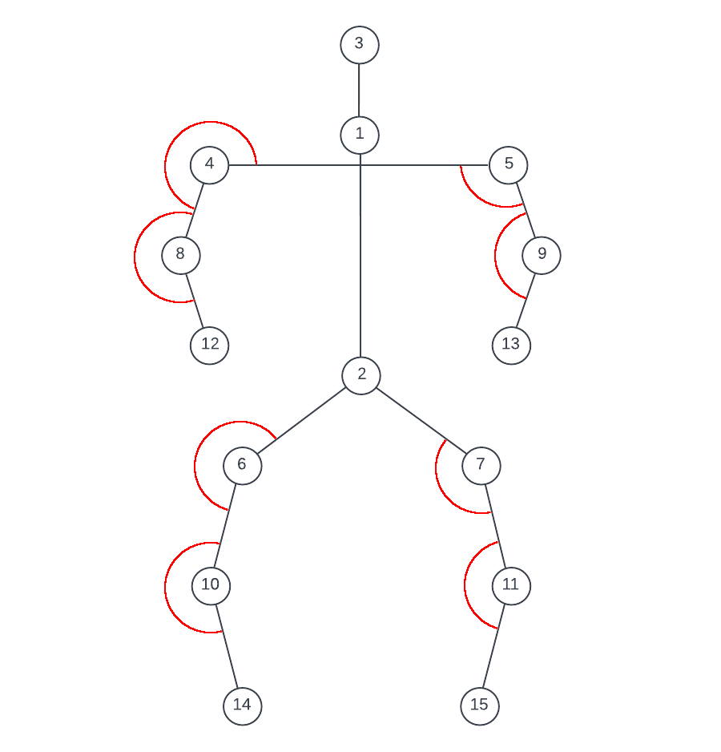
Joint Angles
Our primary goal:
Create a representation based on pose that is resistant to background interference
Solution:
Do not use joint positions, use joint angles

Slide 13
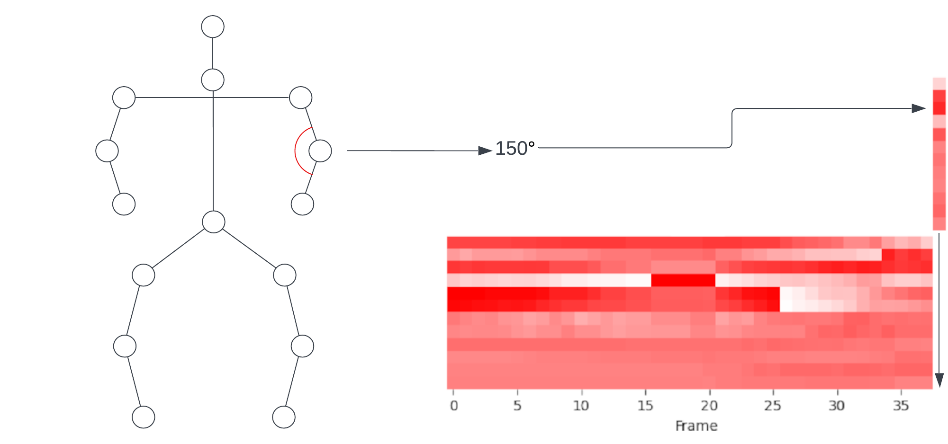
Intermediate Representation
We can take these joint angles from each frame and construct our intermediate representation
Very similar to the EHPI construction, however it is not as vulnerable to the x and y positions of the person in the frame

Slide 14
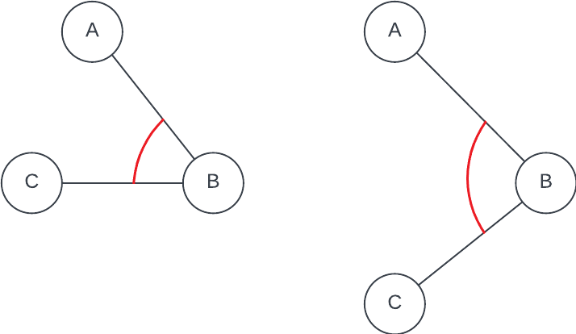
Joint Velocities

Slide 15
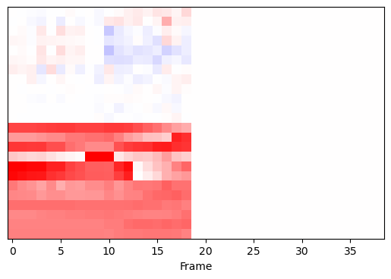
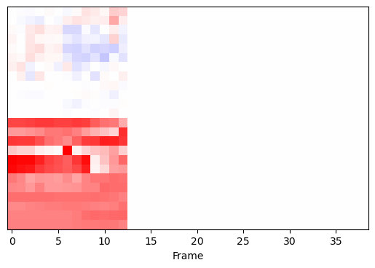
Temporal Adjustments
N=1
N=2

Slide 16
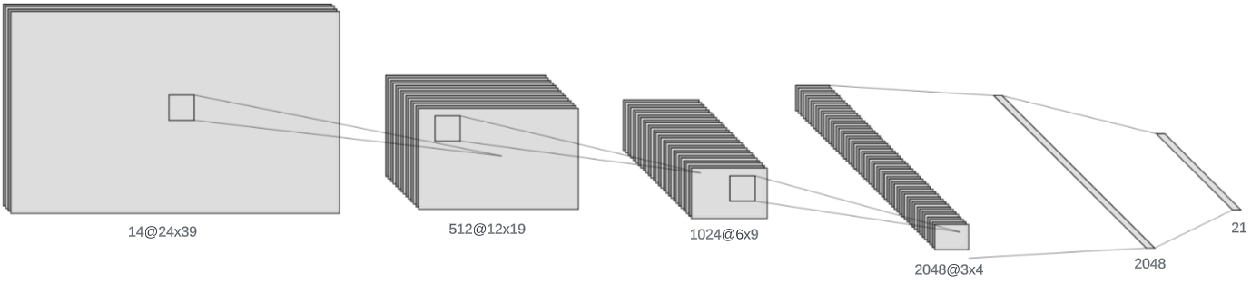
CNN Model Architecture

Slide 17
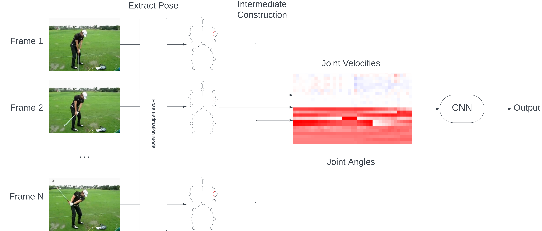
Full Architecture

Slide 18
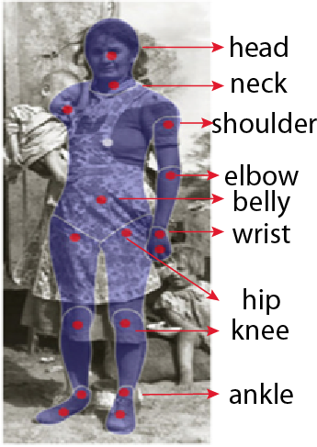
Dataset – JHMDB
JHMDB dataset was chosen for the manually annotated poses
Allows for direct comparisons with other models without considering the pose models being used, means we can ‘isolate’ the techniques used for action recognition
Dataset contains:
21 Classes
36-55 clips per action, 928 total
3 Training/Testing splits

Slide 19
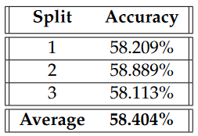
Results

Slide 20
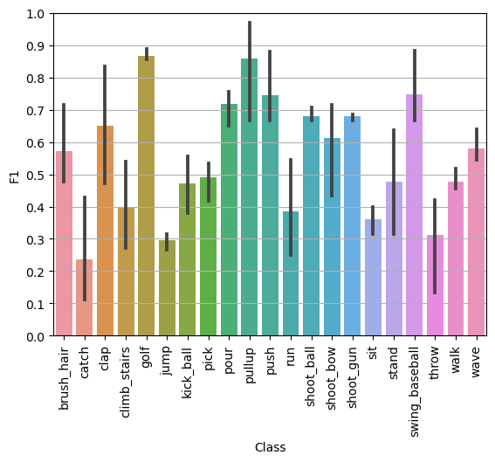
Results

Slide 21
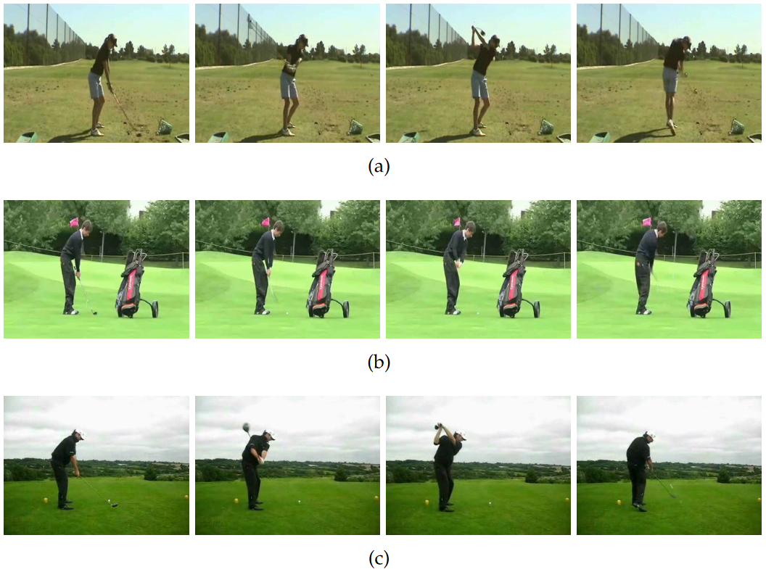
Golf Action – Consistent Movement

Slide 22
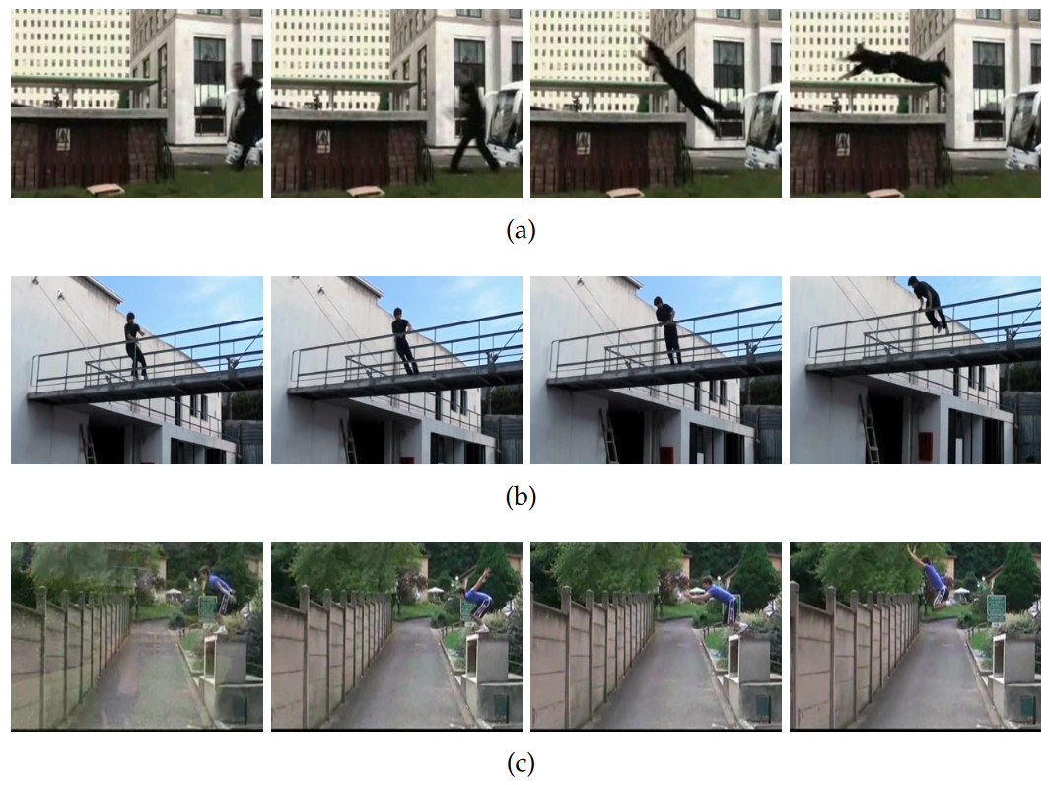
Jump Action – Global Position Change

Slide 23
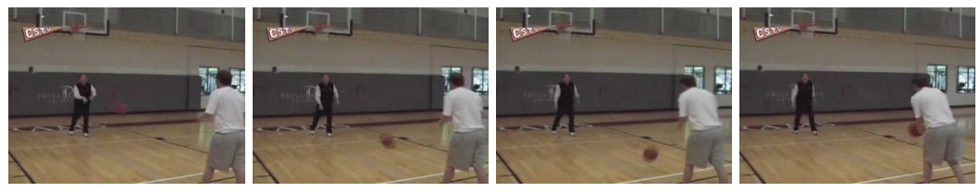
Catch – Object Interaction

Slide 24
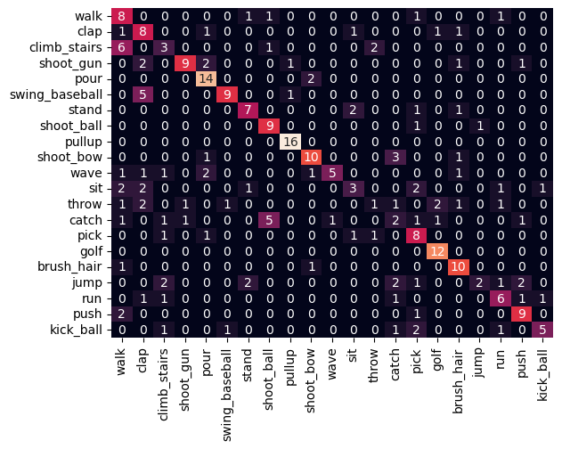
Results - Confusion Matrix
Notes:
Confusion matrix split 1

Slide 25
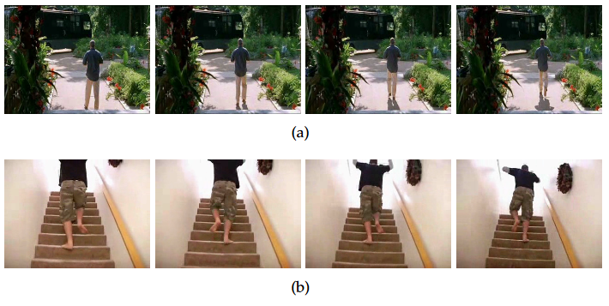
Class Confusion – Walk vs Climb Stairs

Slide 26
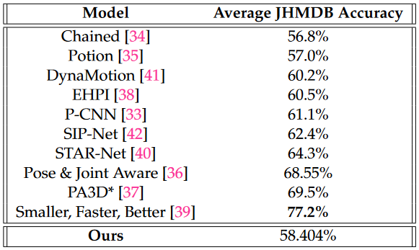
Model Comparison

Slide 27
Results Summary
Our model is not state-of-the-art
Aim to fill a specific niche
Lightweight, very simple models for movement-based actions
Agnostic to global position, scale and rotation
With that comes sacrifices
Global position means we cannot track person moving through the frame
Pose-exclusive model means we cannot see any objects that the person might be interacting with

Slide 28
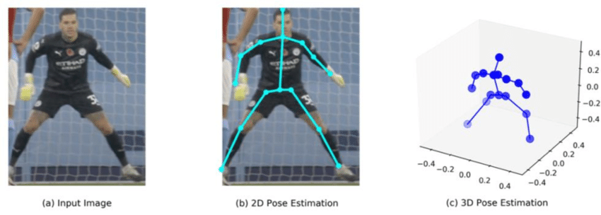
Future Work
Moving from 2-dimensional skeletons to 3-dimensional
Truly camera agnostic
Notes:
Primary goal would be to apply some logic to 3d skeletons
Would require some work as the current logic is based on 2d angles

Slide 29
Thank You!

